Slide 1
Introduction to Neural Networks
Dr. Sifat Momen

Slide 2
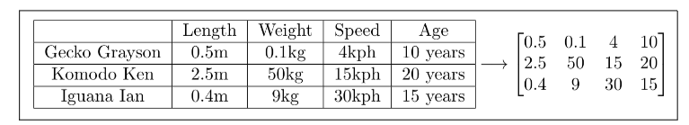
Fundamentals of Linear Algebra for Deep Learning

Slide 3
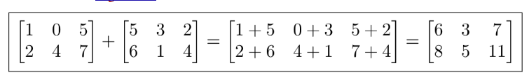
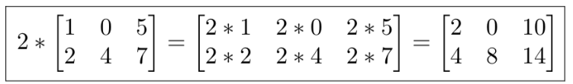
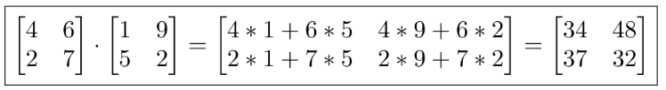
Matrix Operations
Matrix Addition
Scalar Matrix Multiplication
Matrix Multiplication

Slide 4
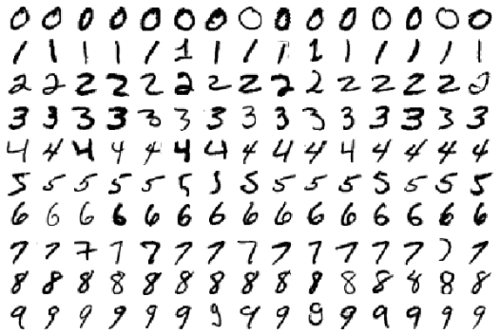

Limits of traditional computer programs
Traditional computer programs are designed to be very good at two things:
Performing arithmetic really fast
Explicitly following a list of instructions

Slide 5
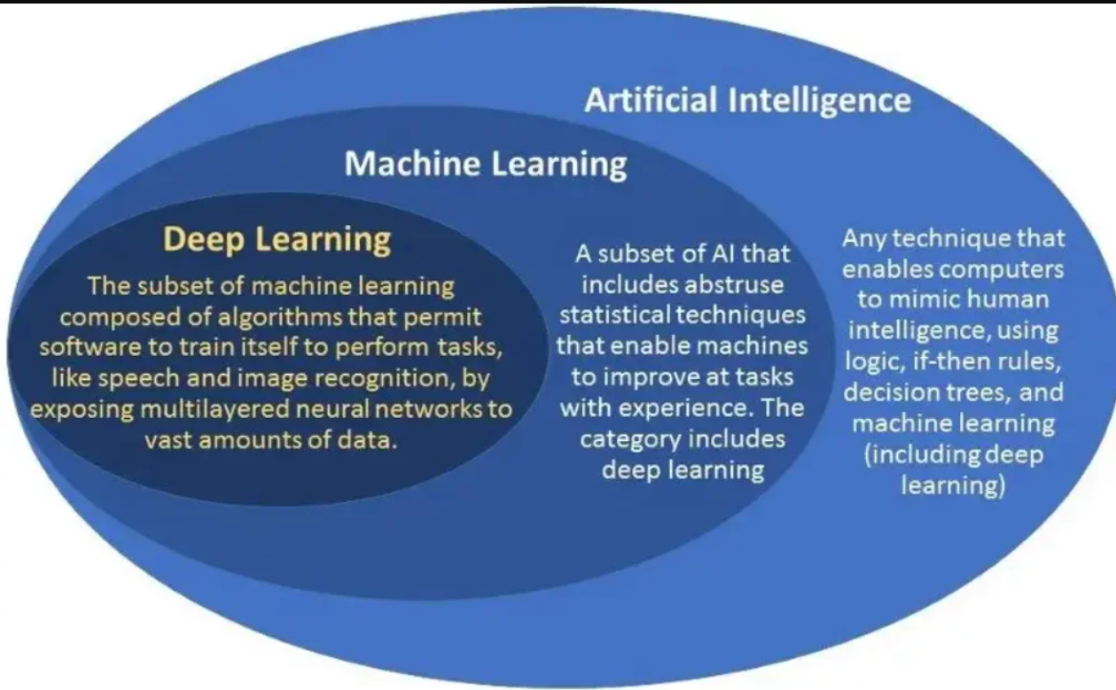
Mechanics of Machine Learning
Deep learning is a subset of machine learning, which itself is a branch of artificial intelligence (AI).
Deep learning focuses on training algorithms called artificial neural networks to learn from large amounts of data. These networks are inspired by the structure and function of the human brain.
Deep learning models learn through a process called representation learning, where they automatically identify patterns in data to perform tasks like classification, regression, and generation.

Slide 6
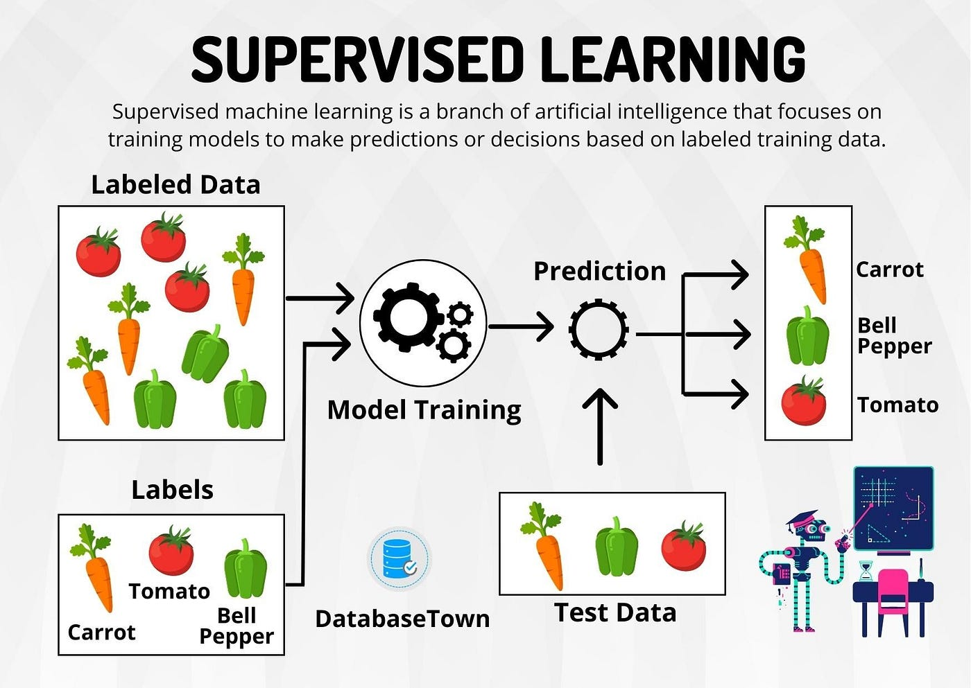

Slide 7
Why deep learning is getting famous now?
Applicability:
Computer vision
Speech recognition
NLP
Machine Translation
Bio-informatics
Drug design,
Medical image analysis
Climate science
Board games programs
Performance
Performance:
Example: Chinese Go game. DL defeated 4 out of 5 times the world champion

Slide 8
Deep learning vs Machine learning
Data Dependency
Hardware Dependency
Training Time
Feature Selection
Interpretability

Slide 9
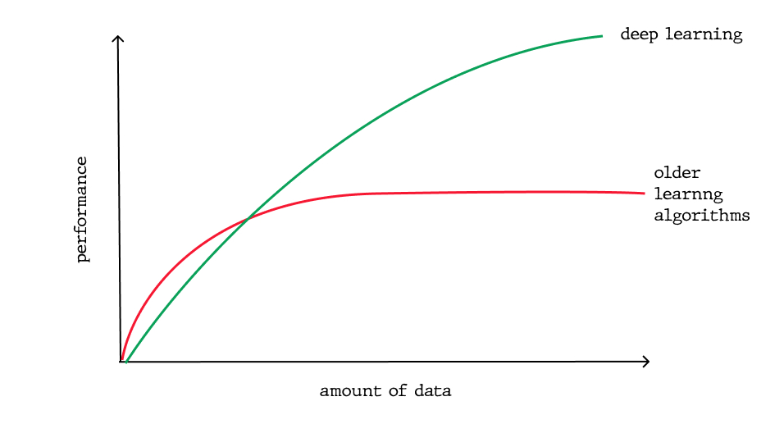
DL vs ML (contd.)
1. Data Dependency
Compared to machine learning, deep learning requires a lot more data.
For less data, ML works better than DL but after a certain point the performance saturates.
Whereas, performance of DL starts increasing almost linearly after a certain point.
DL is data hungry
Deep Learning
Machine Learning
Performance
Amount of data

Slide 10
DL vs ML (contd.)
2. Hardware Dependency
Machine learning algorithms can work in CPU.
But in DL, there are complex matrix multiplications. So running them in CPU will be slow. It requires powerful GPUs with more memory.
3. Training Time
DL models are complex, so model training time is high (as high as in weeks)
ML model training time is low compared to low.
Prediction time for DL is very fast. On the other hand, in ML, prediction with algorithms like KNN is very slow.
4. Feature Selection:
DL uses representation learning, where features are automatically extracted.
But in ML, features are manually chosen first and then need feature engineering for performance enhancement.

Slide 11
DL vs ML (contd.)
5. Interpretability:
Because of representation learning in DL, features are extracted automatically and the entire architecture works as a black box. So interpretability is hard.

Slide 12
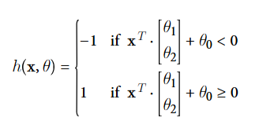
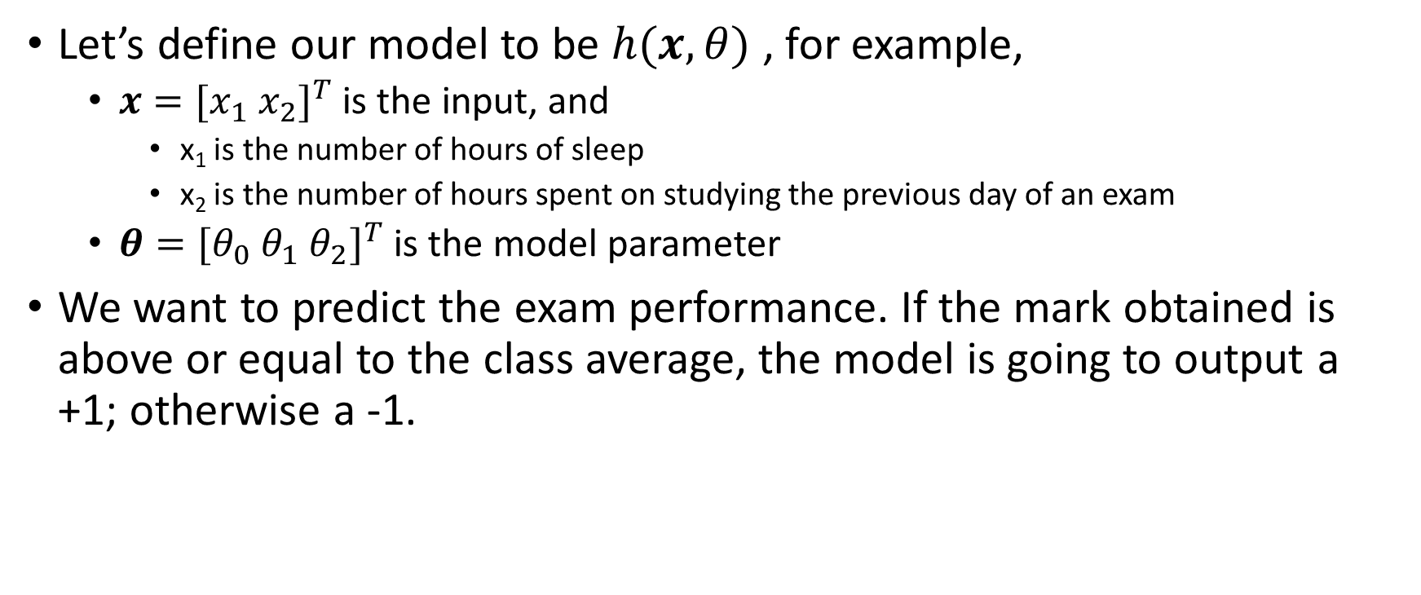
Linear Perceptron
Let’s define our model to be $h(x, θ)$ , for example,
$x=[x_{1} x_{2}]^{T}$ is the input, and
x₁ is the number of hours of sleep
x₂ is the number of hours spent on studying the previous day of an exam
$θ=[θ_{0} θ_{1} θ_{2}]^{T}$ is the model parameter
We want to predict the exam performance. If the mark obtained is above or equal to the class average, the model is going to output a +1; otherwise a -1.

Slide 13

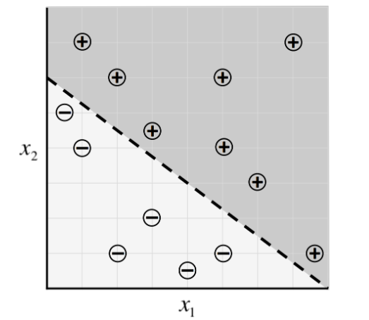
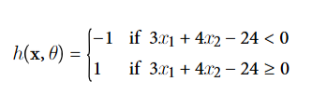
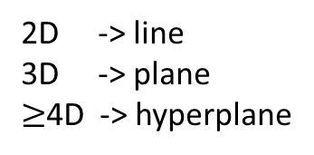
Linear Perceptron
2D -> line
3D -> plane
$≥$4D -> hyperplane

Slide 14
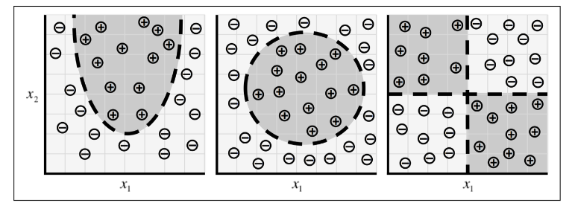
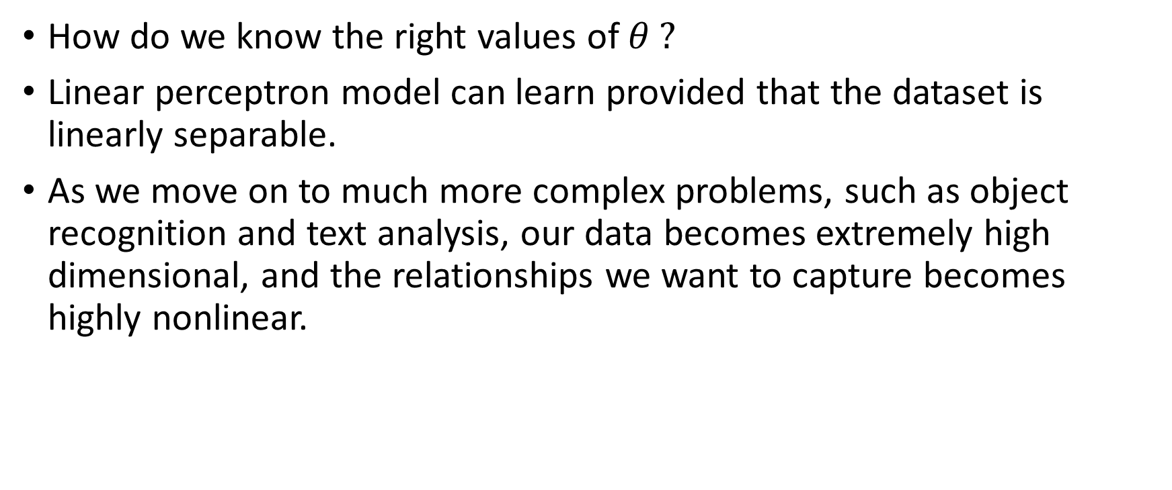
Issues
How do we know the right values of $θ ?$
Linear perceptron model can learn provided that the dataset is linearly separable.
As we move on to much more complex problems, such as object recognition and text analysis, our data becomes extremely high dimensional, and the relationships we want to capture becomes highly nonlinear.

Slide 15
Neuron
Foundational unit of a human brain is a neuron.
A tiny piece of a brain, about the size of grain of rice, contains over 10,000 neurons, each of which forms an average of 6,000 connections with other neurons.
It’s this massive biological network that enables us to experience the world around us.

Slide 16
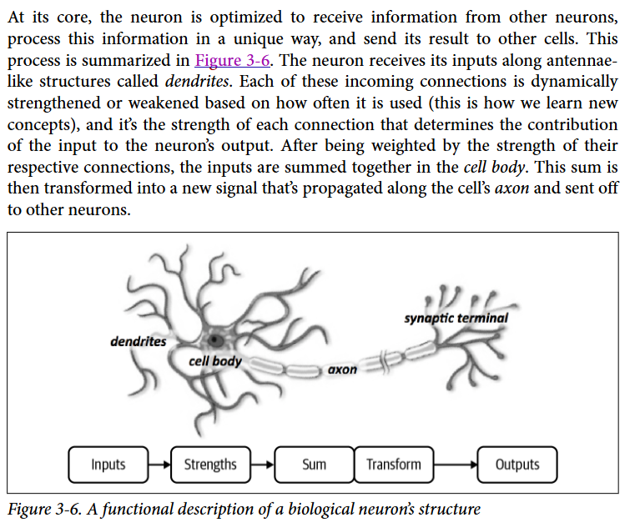
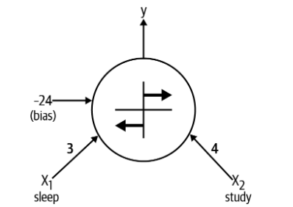


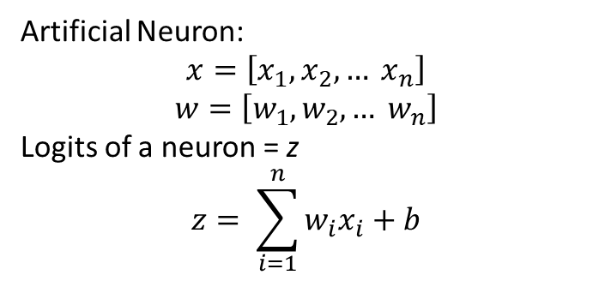
Expressing linear perceptron as neurons
Artificial Neuron:
$$x=\left[x_{1}, x_{2}, … x_{n}\right]$$
$$w=\left[w_{1}, w_{2}, … w_{n}\right]$$
Logits of a neuron = z
$$z= \sum_{i=1}^{n}{w_{i}x_{i}+b}$$

Slide 17
Feed-forward neural networks
A single neuron is not expressive enough to solve complicated learning problems.
That’s the reason, our brain is made of more than one neuron.
In fact, the neurons in our brain are organized in layers.
The human cerebral cortex (the structure responsible for most of the human intelligence) is made up of 6 layers.
Information flows from one layer to another until sensory input is converted into conceptual understanding.

Slide 18
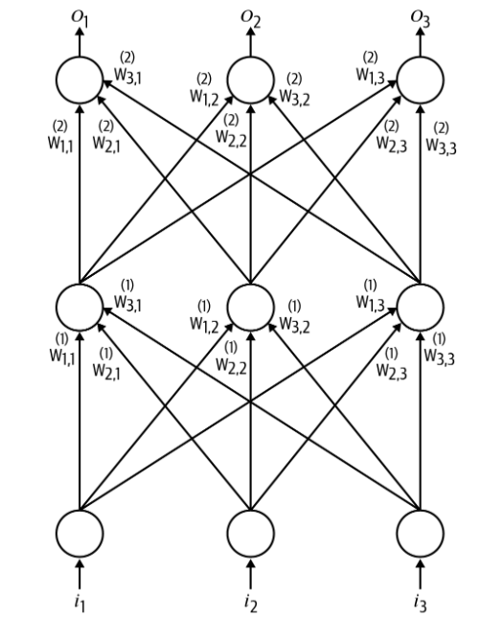
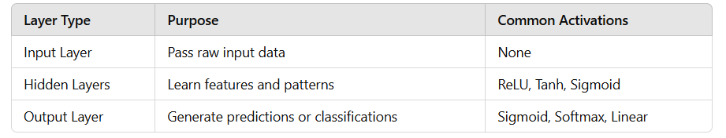
Feed-forward neural network
Input Layer:
Introduces raw input data into the network
Each neuron in this layer corresponds to one feature of the input data.
The input layer does not perform any computation; it simply passes the data to the next layer.
Hidden Layer:
Hidden layers are where the majority of the learning happens.
Output Layer:
Produces the final output of the network, which can be:
A single value (e.g., regression).
Class probabilities (e.g., classification).

Slide 19
Linear Neurons and their limitations
Linear neurons are easy to compute with, but they run into serious limitations.
Infact, it can be shown that any feed-forward neural network consisting of only linear neurons can be expressed as a network with no hidden layers.
This is problematic because, as we discussed, hidden layers are what enable us to learn important features from the input data. In other words, to learn complex relationships, we need to use neurons that employ some sort of nonlinearity.
1
b = 1
x₂
w₂ = 4
Σ
A
w₁ = 2
x₁

Slide 20

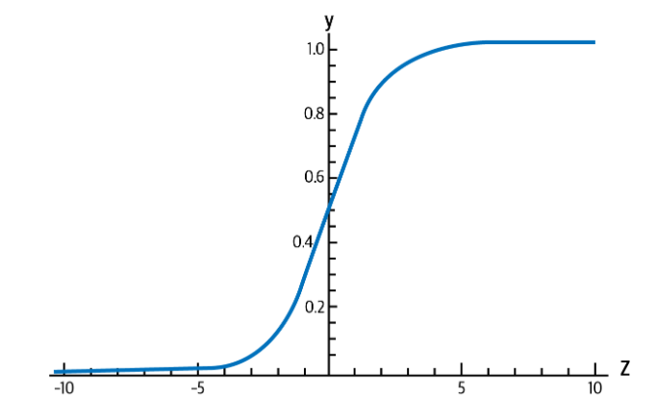
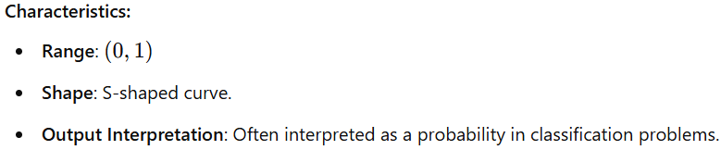
Sigmoid, Tanh, and ReLU Neurons
They introduce nonlinearities in their computations.
These neurons use different activation functions on the logits.
Sigmoid function

Slide 21

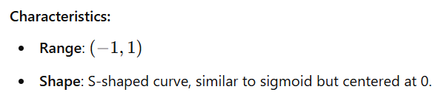
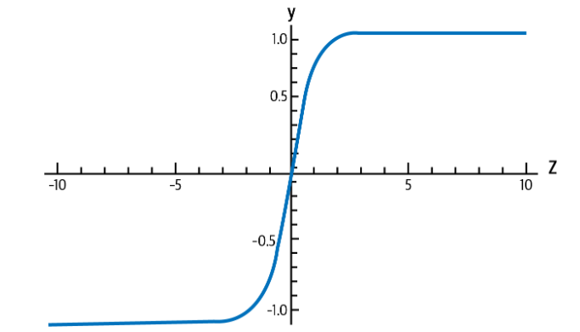
Tanh Neurons
These neurons apply tanh (hyperbolic tangent) functions as activation functions

Slide 22

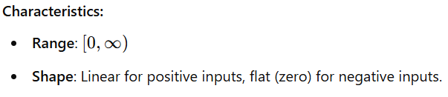
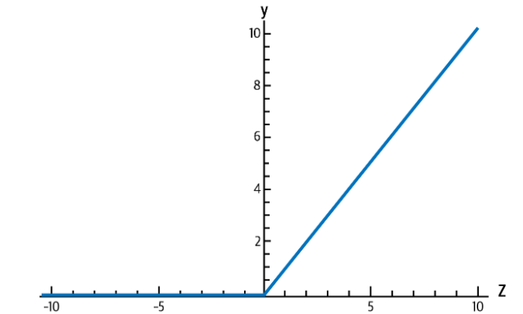
ReLU Neurons
They apply ReLU functions as activation functions.

Slide 23

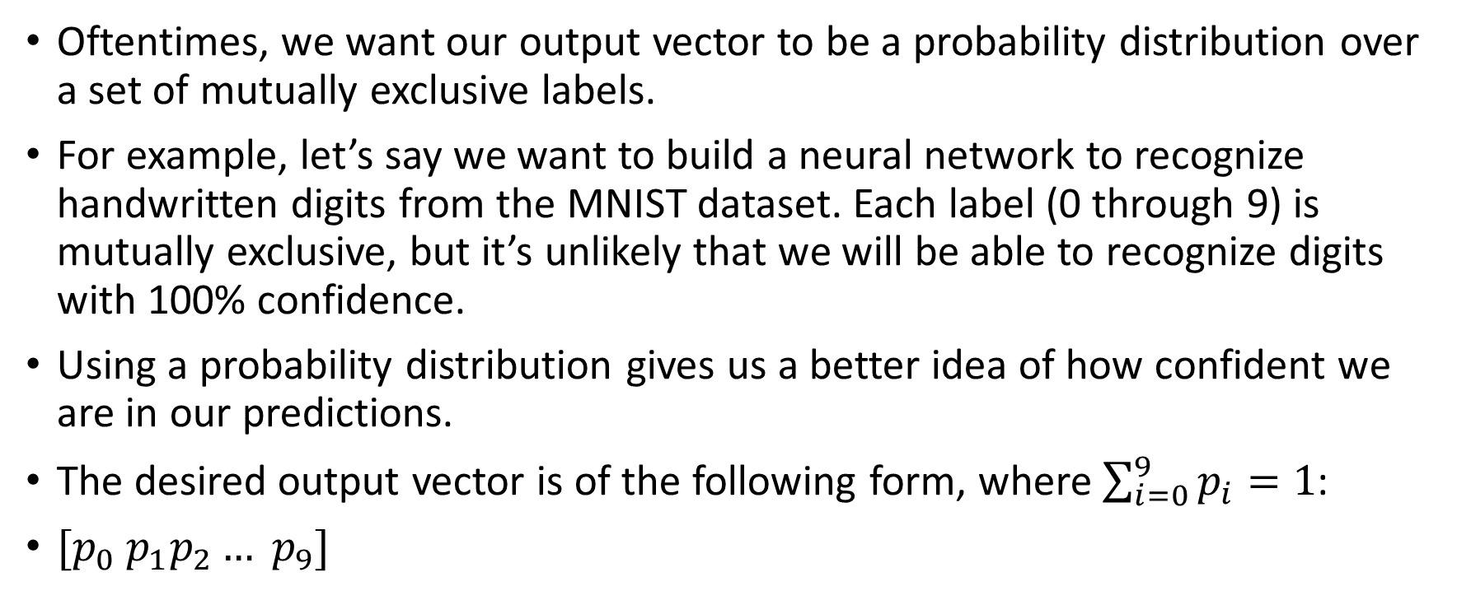
Softmax Output layer
Oftentimes, we want our output vector to be a probability distribution over a set of mutually exclusive labels.
For example, let’s say we want to build a neural network to recognize handwritten digits from the MNIST dataset. Each label (0 through 9) is mutually exclusive, but it’s unlikely that we will be able to recognize digits with 100% confidence.
Using a probability distribution gives us a better idea of how confident we are in our predictions.
The desired output vector is of the following form, where $\sum_{i=0}^{9}{p_{i}=1}$:
$[p_{0} p_{1}p_{2}… p_{9}]$

Slide 24
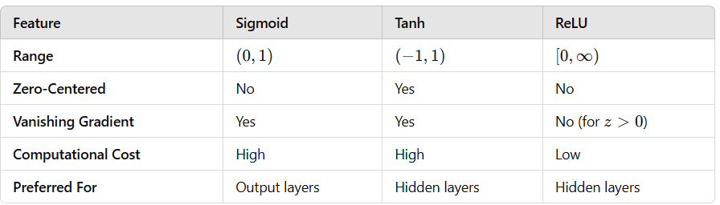
Comparison of Sigmoid Tanh, and ReLU

Slide 25
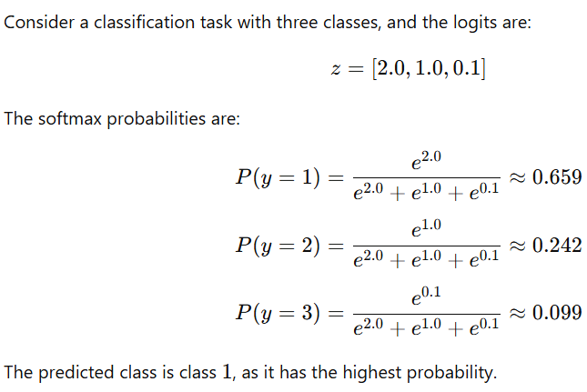
Example of Softmax function

Slide 26
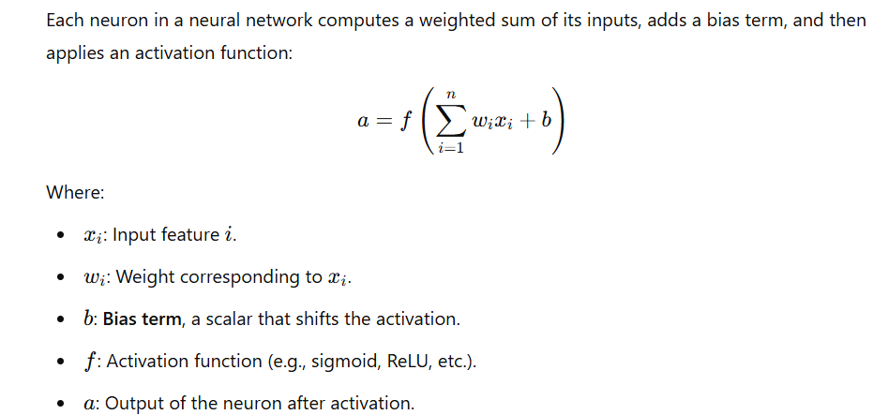
Role of Bias in a neural network

Slide 27
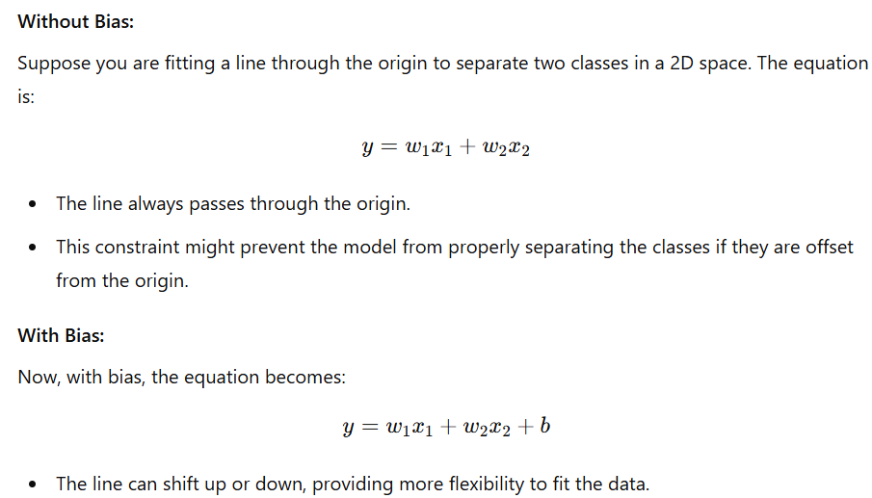
Example of Bias in action

